Slide 1
Citing Hierarchical Data A Map-Reduce Approach
Ariel Eizenberg, CIS 700-002 2016

Slide 2
Motivation
Hierarchical data is different in nature from RDBMs
Citing shouldn’t just include row and DB information
Potentially can include other related hierarchy elements
“Why data citation is a computational problem?” paper
Proposes that data citation is a computational problem
Suggests a mechanism for generating citations automatically
Overview
Datasets
Rule language
Extensions

Slide 3
Requirements
A language describing citations policy
Rules and policies should be specified in terms of the schema
Given a hierarchical dataset + extra metadata, generates the appropriate citation.
Allow a wide range of policies, examples:
Direct citation of the data
Citation for the root (this should always have a citation of some sort
Citation of portion of the path between the data and the root
Union of citations of some citable descendent nodes
Combination of above
Overview
Datasets
Rule language
Extensions

Slide 4
Dataset types
Structure
True hierarchical – stored in hierarchical form (XML, json)
Semi hierarchical – stored in RDMS, with hierarchical schema
Possible to generate XML automatically using schema
Mixed – stored in RDMS, with some schema hierarchy information
Requires manual mappings to generate XML
RBMS – tabular form only
Citation
Just cite the dataset
Cite using some manual procedure,
e.g. find closest paper from a list
Citations in dataset itself
Overview
Datasets
Rule language
Extensions

Slide 5
Dataset types
Structure
True hierarchical – stored in hierarchical form (XML, json)
Semi hierarchical – stored in RDMS, with hierarchical schema
Possible to generate XML automatically using schema
Mixed – stored in RDMS, with some schema hierarchy information
Requires manual mappings to generate XML
RBMS – tabular form only
Citation
Just cite the dataset
Cite using some manual procedure,
e.g. find closest paper from a list
Citations in dataset itself
Overview
Datasets
Rule language
Extensions

Slide 6
Dataset #1 - Guide to Pharmacology
“Guide to Pharmacology” (www.guidetopharmacology.org)
Data is not natively hierarchical, but is organized hierarchicaly.
Dataset stored in PostgreSQL, can be roughly converted to XML based on schema
Initial scripts by Peter Buneman
Updated for current schema
~80MB XML
Overview
Datasets
Rule language
Extensions

Slide 7
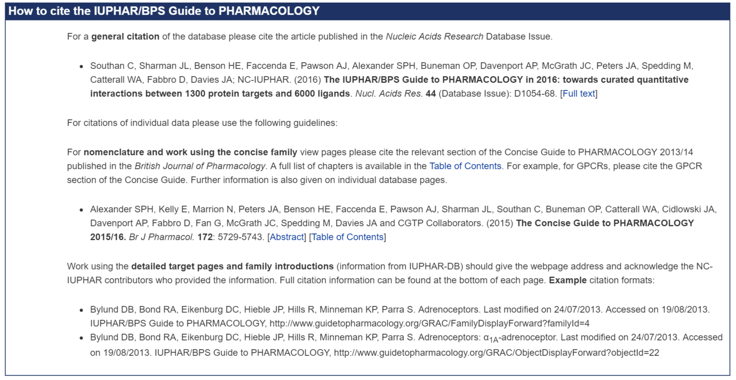
Overview
Datasets
Rule language
Extensions

Slide 8
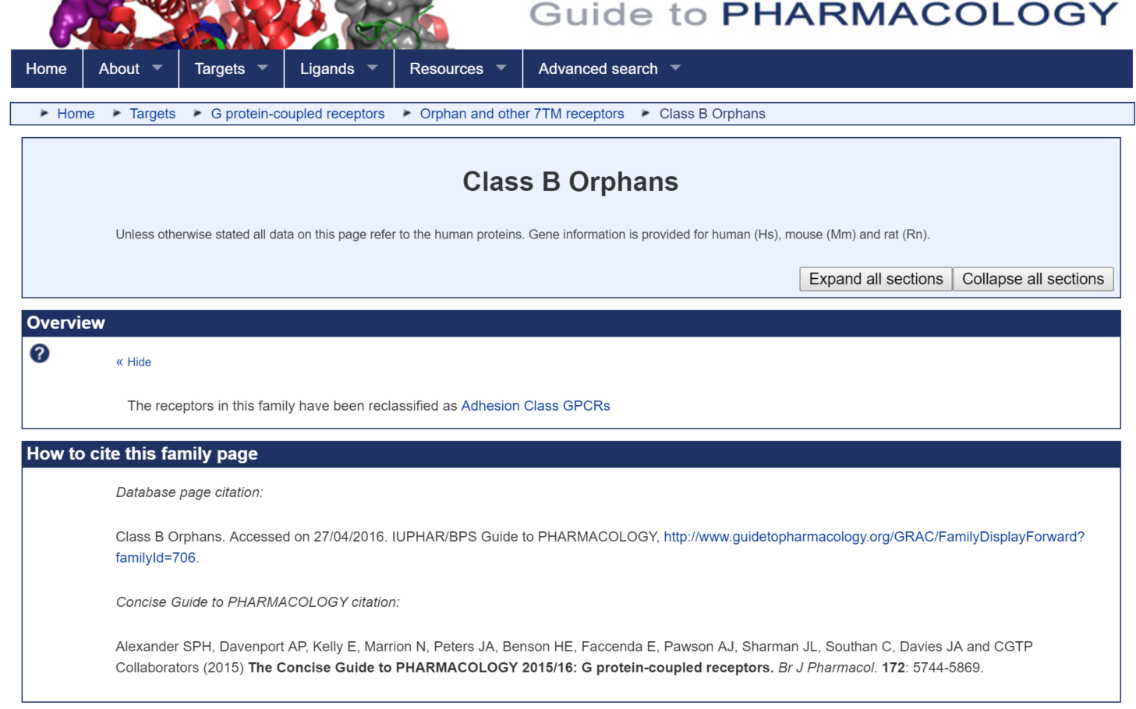
Overview
Datasets
Rule language
Extensions

Slide 9
Structure & Citing Rules
/
Group
Group
Group
...
Group
Family
...
Family
Group
Family
Object
Object
Object
Object
Family
Intro
Intro
Object
Intro
Object
Explicit
Implicit
Overview
Datasets
Rule language
Extensions

Slide 10
Citation Data
TABLE contributor (contributor_id integer, address text, email char(500), first_names char(500), surname char(500), suffix char(200), note char(1000));
TABLE contributor2family(contributor_id integer, family_id integer, role char(50), display_order integer);
TABLE contributor2intro(contributor_id integer, family_id integer, display_order integer);
TABLE contributor2object(contributor_id integer, object_id integer, display_order integer);
Overview
Datasets
Rule language
Extensions

Slide 11
Citation from page
Citation from family root
Overview
Datasets
Rule language
Extensions

Slide 12
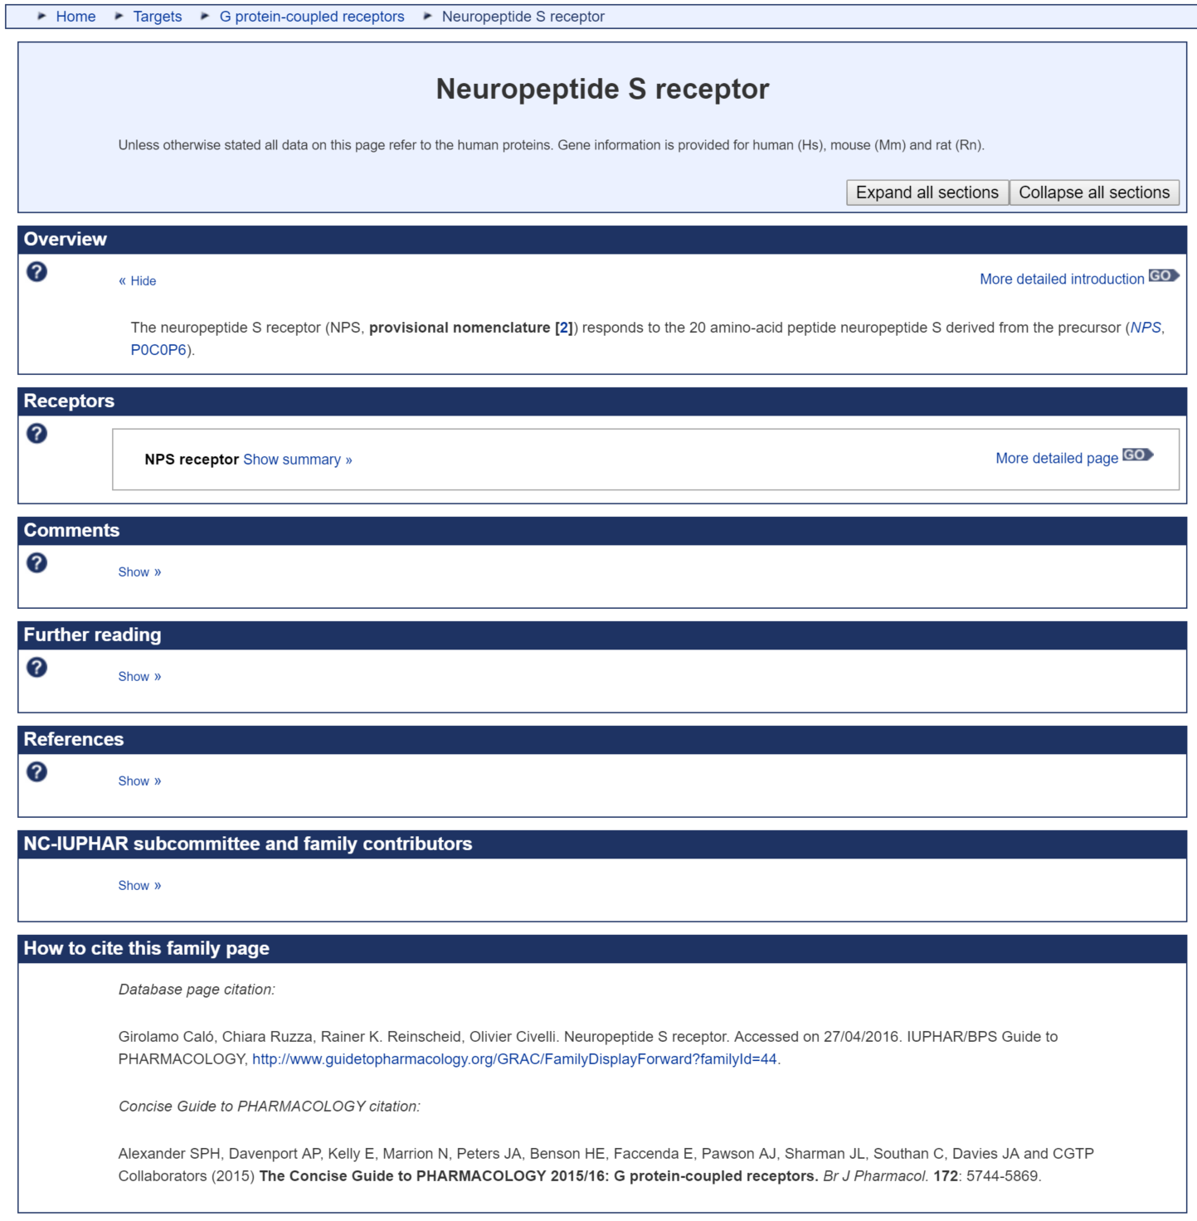
Citation from object
Citation from family root
Overview
Datasets
Rule language
Extensions

Slide 13
Dataset #2 – Reactome Pathway Database
A curated pathway database (http://www.reactome.org/)
Data is not natively hierarchical, but is organized hierarchicaly.
Dataset stored in MySQL, can be roughly converted to XML based on schema
Even has a builtin REST API generating XML/JSON for a database object
Expanded to extract entire DB (>1GB XML)
Overview
Datasets
Rule language
Extensions

Slide 14
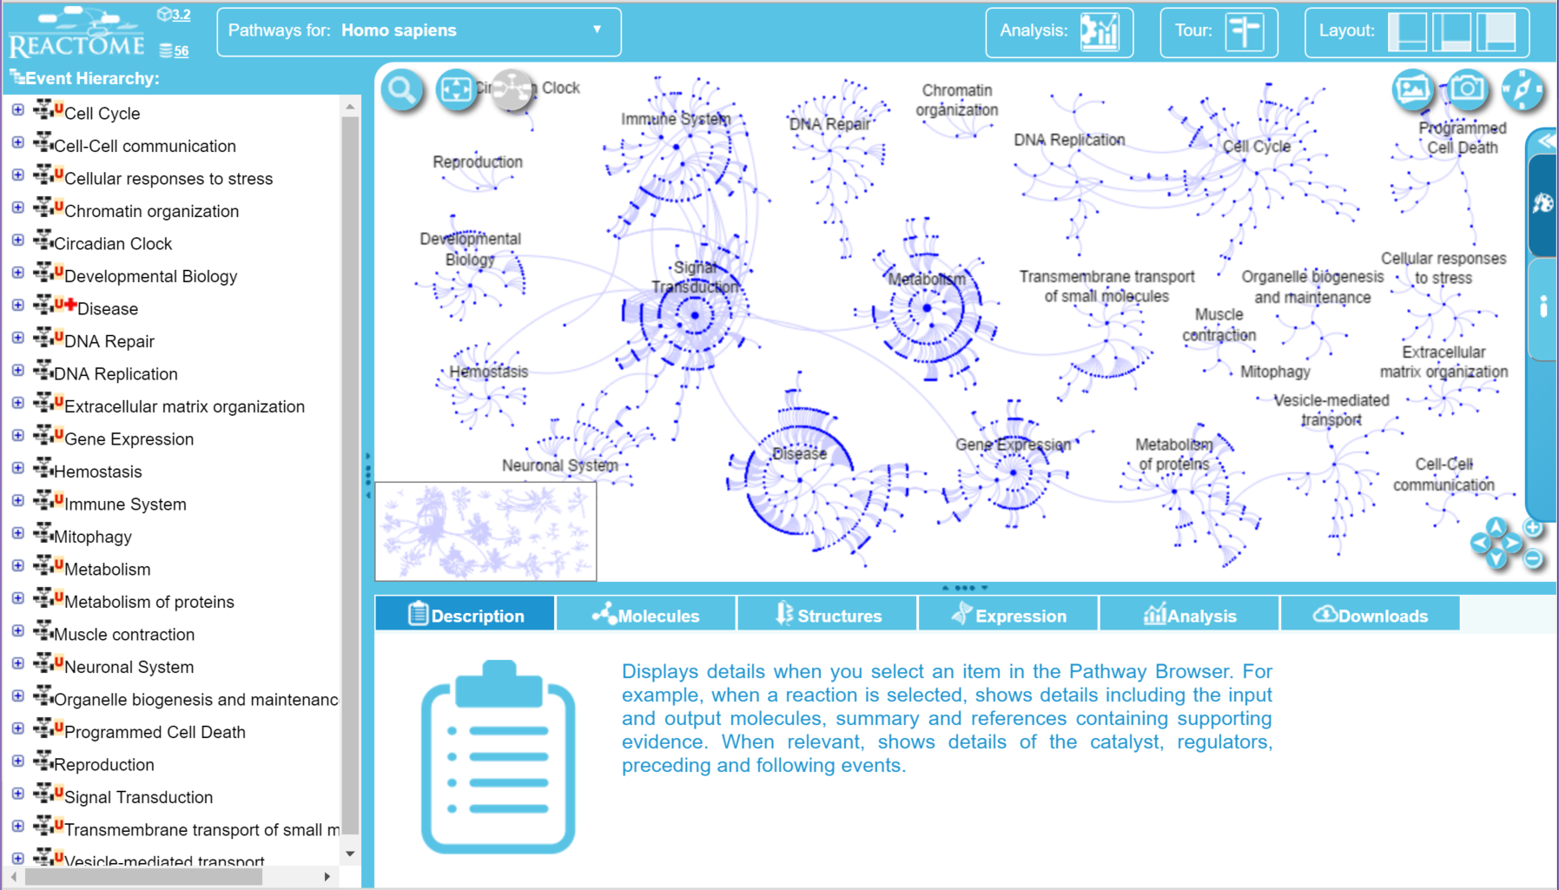
Overview
Datasets
Rule language
Extensions

Slide 15
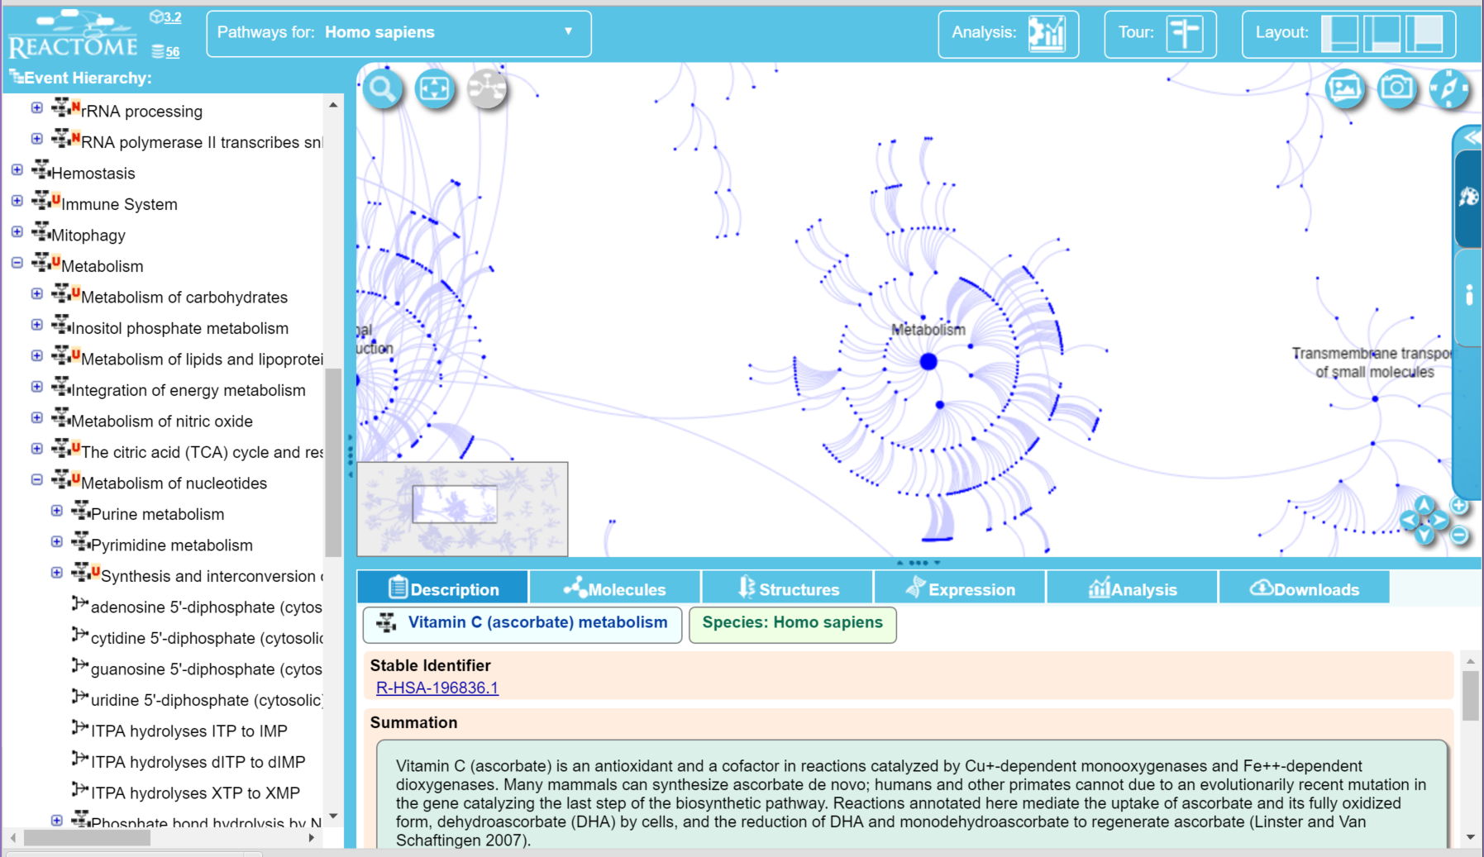
Overview
Datasets
Rule language
Extensions

Slide 16
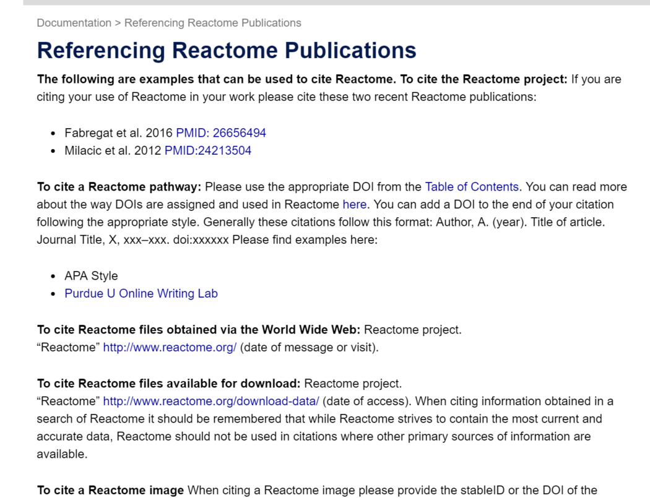
Overview
Datasets
Rule language
Extensions

Slide 17
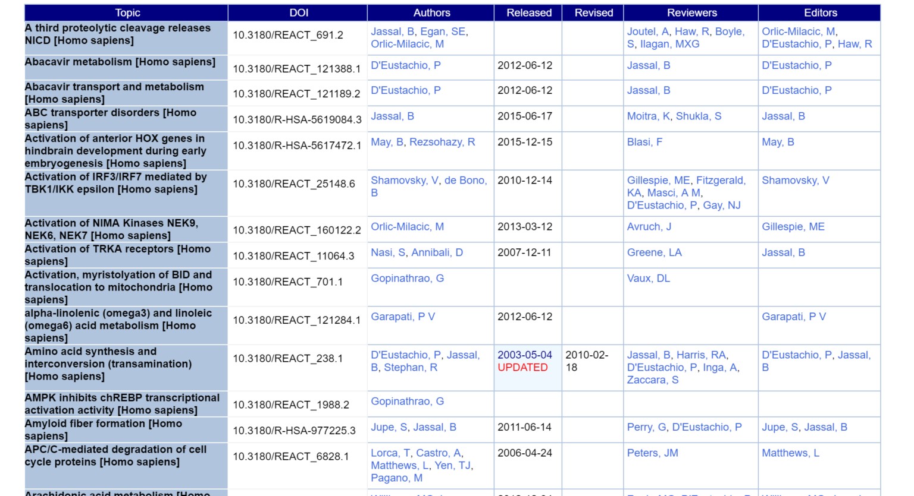
~336 DOIs
Overview
Datasets
Rule language
Extensions

Slide 18
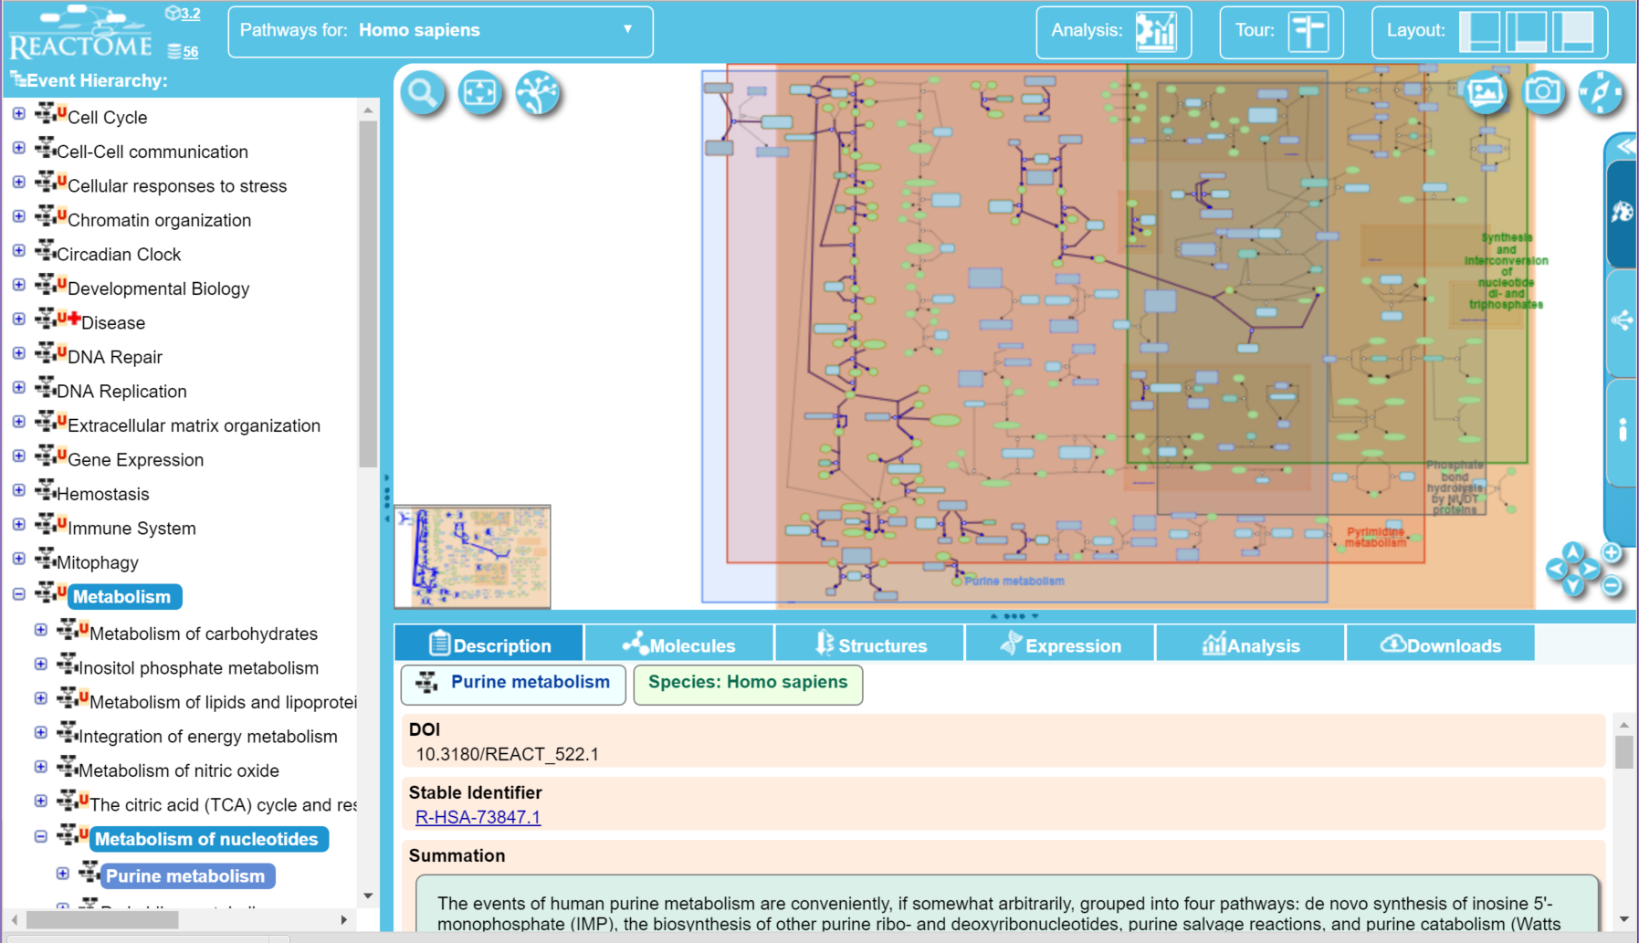
Direct DOI
Overview
Datasets
Rule language
Extensions

Slide 19
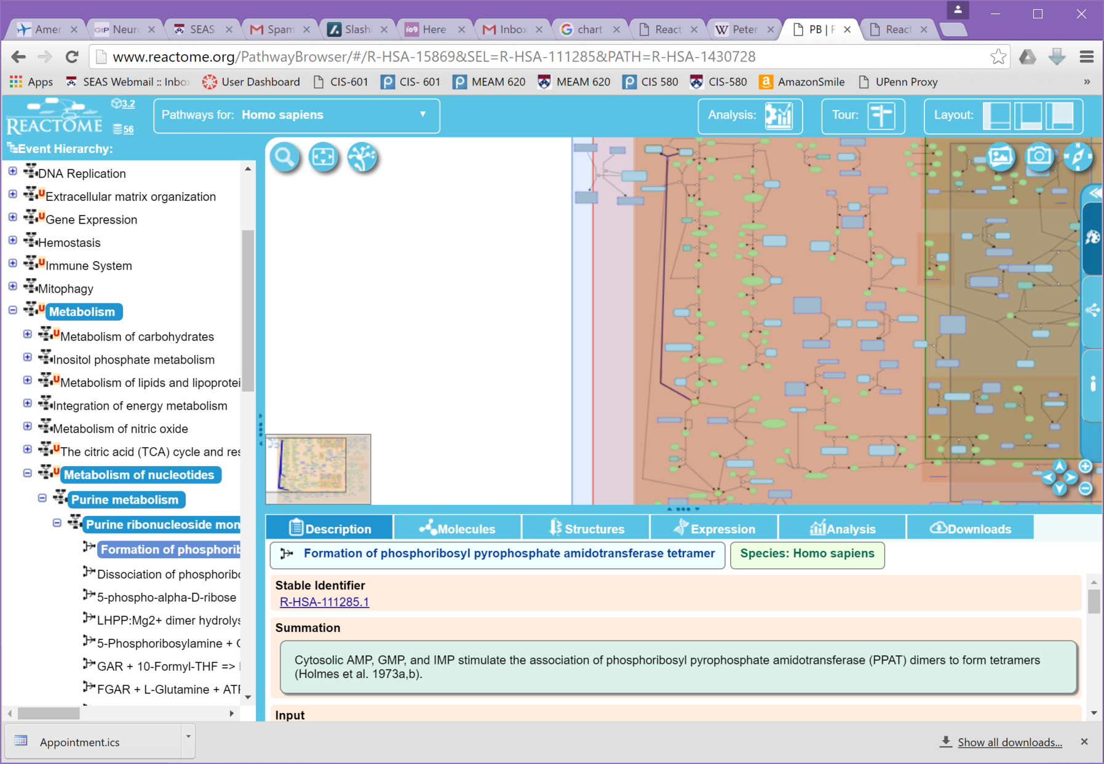
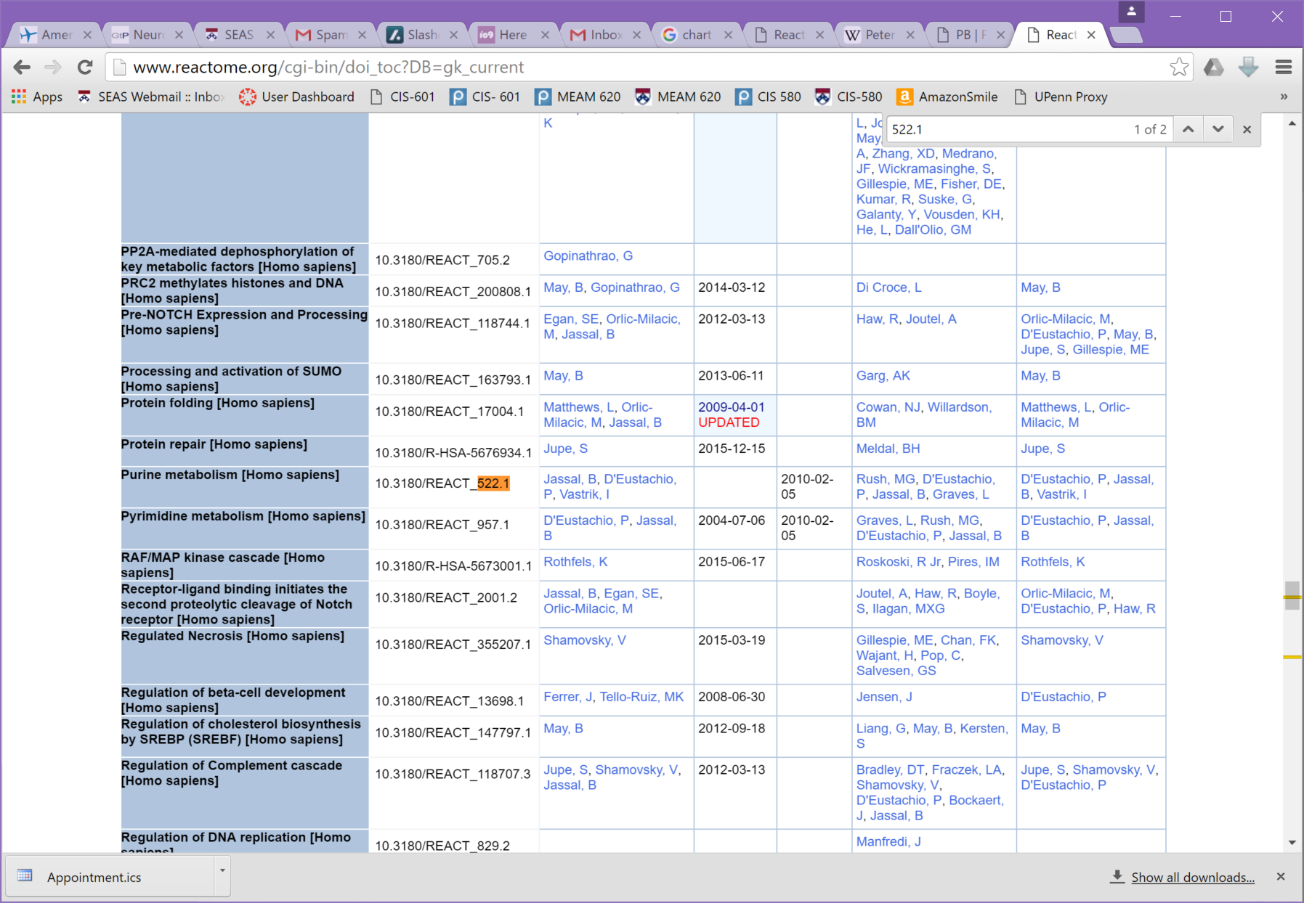

Slide 20
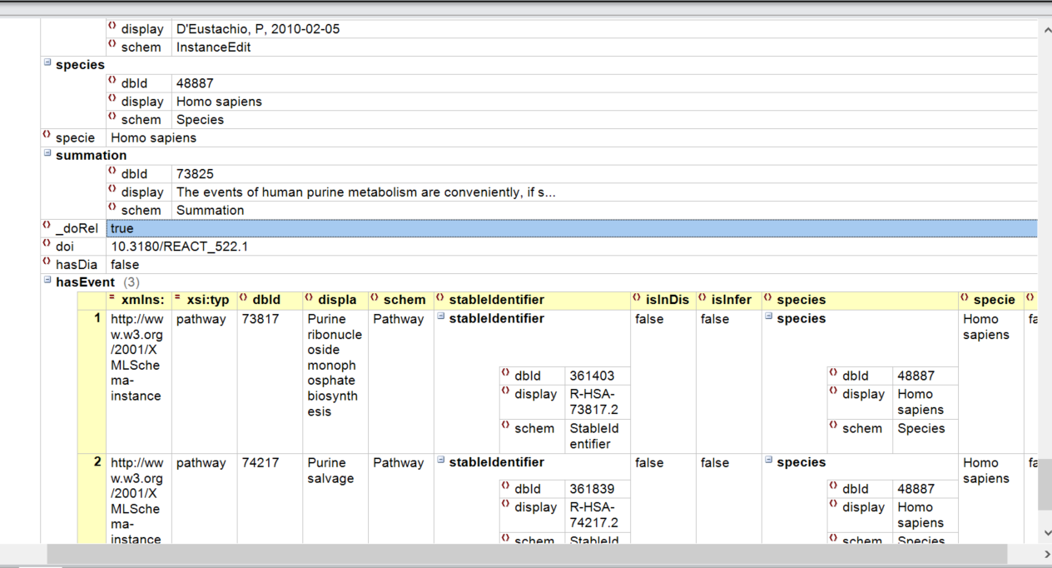
Citing
Can this be done automatically?
Yes!
<pathway> <pathway> <pathway> Data </pathway>
</pathway> <doi>DOI</doi> </pathway>
Overview
Datasets
Rule language
Extensions

Slide 21
Hierarchical Citing as Map-Reduce
Step 1:
Generate a list of paths from the cited node
Path to each ancestor
Path to each descendent
Step 2:
Map XPath unto paths
Remove nonexistent paths
Step 3:
Reduces paths
Step 4:
Repeat as needed
Step 5:
Use XSLT to display (transform to txt, bibtex, html, XML, …)
Overview
Datasets
Rule language
Extensions

Slide 22
Example #1 (Guide to Pharmacology)
Example: $last($ancestors/contributors/*)
Step 1 – Get all ancestors paths
{/, /gpcr, /gpcr/family[ID=…], /gpcr/family[ID=…]/family[ID=…], …}
Step 2 – Map XPath “/contributors/*”
{/contributors/*, /gpcr/contributors/*, /gpcr/family[ID=…]/contributors/*, /gpcr/family[ID=…]/family[ID=…] /contributors/*, …}
Remove nonexistent paths: {/gpcr/contributors/*, /gpcr/family[ID=…]/contributors/*}
Step 3 – Reduce
$last returns last entry in list:
{/gpcr/contributors/*, /gpcr/family[ID=…]/contributors/*}
Overview
Datasets
Rule language
Extensions

Slide 23
Example #2 (Guide to Pharmacology)
Example: $all($ancestors/contributors/email/text())
All contributors sub-nodes of nodes in path
Step 1 – Get all ancestors paths
{/, /gpcr, /gpcr/family[ID=…], /gpcr/family[ID=…]/family[ID=…], …}
Step 2 – Map XPath “/contributors/name/text()”
{/contributors/email/text(), /gpcr/contributors/email/text(), /gpcr/family[ID=…]/contributors/email/text(), /gpcr/family[ID=…]/family[ID=…] /contributors/email/text(), …}
Remove nonexistent paths: {“p.monk@sheffield.ac.uk”, “Bernard.Mouillac@igf.cnrs.fr”}
Step 3 – Reduce
Returns all entries in list
{“p.monk@sheffield.ac.uk”, “Bernard.Mouillac@igf.cnrs.fr”}
Overview
Datasets
Rule language
Extensions

Slide 24
Example #3 (Guide to Pharmacology)
Example: $all($last($ancestors/contributors/*),$last($ancestors/intro/contributors/*))
Contributors from node and introductions
Process $last($ancestors/contributors/*)
Step 1 – Get all ancestors paths
{/, /gpcr, /gpcr/family[ID=…], /gpcr/family[ID=…]/family[ID=…], …}
Step 2 – Map XPath “/contributors/*”
{/contributors/*, /gpcr/contributors/*, /gpcr/family[ID=…]/contributors/*, /gpcr/family[ID=…]/family[ID=…] /contributors/*, …}
Remove nonexistent paths: {/gpcr/contributors/*, /gpcr/family[ID=…]/contributors/*}
Step 3 – Reduce
$last returns last entry in list:
{/gpcr/contributors/*, /gpcr/family[ID=…]/contributors/*}
Process $last($ancestors/intro/contributors/*)
…
Get {/gpcr/family[ID=…]/intro/contributors/*}
Process $all({/gpcr/family[ID=…]/contributors/*, /gpcr/family[ID=…]/intro/contributors/*}
Return both entries
Overview
Datasets
Rule language
Extensions

Slide 25
Example #4 (Guide to Pharmacology)
Example:
Rule: $last($ancestors[contributors])
XSLT:
<xsl:stylesheet>
<xsl:template match=“/name”><xsl:value-of select=“text()”><xsl:text>, </xsl:text> <xsl:template match=“/intro/contributors”> <xsl:value-of select=“first-name”/><xsl:value-of select=“last-name” /> <xsl:text>, </xsl:text> </xsl:template>
<xsl:template match=“/contributors”> <xsl:value-of select=“first-name”/><xsl:value-of select=“last-name” /> <xsl:if test=“position() != last()”><xsl:text>, </xsl:text></xsl:if> </xsl:template>
</xsl:stylesheet>
Print name, nearest ancestor contributors and, if exists, introduction page contributors (for that ancestor), and format as a comma-separated list
Overview
Datasets
Rule language
Extensions

Slide 26
More Examples
$all($last($ancestors[contributors/ and intro/contributors/]))
Contributors from node that has corresponding introduction
$all($root/contributors/*)
All contributors of root
$all($descendant/contributors/*)
Contributors from child nodes
$last($ancestors/grac_comments/*,$ancestors/comments/*)
Comments (preferred) or Grac Comments
$all($const(“<xml>…</xml>”), $last($ancestors/contributors/*))
Add a constant XML data source
$all($const(“<xml><version>$1</version></xml>”, $last(/db/@version)), $last($ancestors/contributors/*))
Add a constant XML data source, plugin in value from citation expression
$all($external(“fmt.xml”, $all($ancestors/authors)), $last($ancestors/contributors/*))
Get constant XML from external file, duplicate for each author entry in all ancestors
Overview
Datasets
Rule language
Extensions

Slide 27
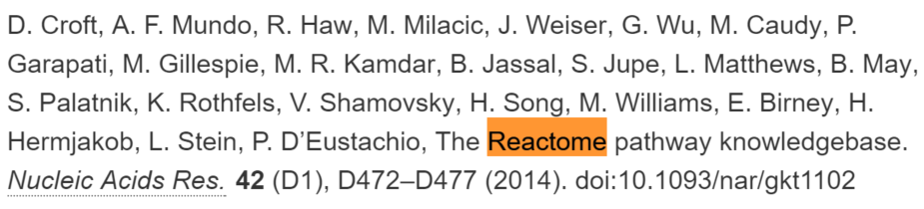
Example #5 (Reactome)
$const(“D. Croft, A. F. Mundo, R. Haw, M. Milacic, J. Weiser, G. Wu, M. Caudy, P. Garapati, M. Gillespie, M. R. Kamdar, B. Jassal, S. Jupe, L. Matthews, B. May, S. Palatnik, K. Rothfels, V. Shamovsky, H. Song, M. Williams, E. Birney, H. Hermjakob, L. Stein, P. D’Eustachio, The Reactome pathway knowledgebase. Nucleic Acids Res. 42 (D1), D472–D477 (2014). doi:$1”,$last($ancestors/doi/text()))
Will generate
Overview
Datasets
Rule language
Extensions

Slide 28
Formal Definition
Sources
$node –the cited node (as a single item list)
$root – the root node (as a single item list)
$ancestors – list of all ancestors
$descendants – list of all descendants
$siblings – list of all siblings
Map operations
Any valid XPath expression (or JSONPath?)
Reduce operations
$first(list) – return first item in list
$last(list) – return last item in list
$count(list) – number of items in list
$all(list) – all items in list
$const(text,variables) – patch variables into text
$external(file,variables) – patch variables into text from external file
Implicit union using commas
Overview
Datasets
Rule language
Extensions

Slide 29
Extension to graphs
Extend sources to support graph operations
$path-to(node-id, [required classes in path])
Shortest path to node (through optional node classes)
$path-from(node-id, [required classes in path])
Shortest path from node (through optional node classes)
$path-to-closest(node-class , [required classes in path]))
Generate path to closest node of type class (through optional node classes)
$path-from-closest(node-class , [required classes in path]))
Generate path to closest node of type class (through optional node classes)
$closest(node-class)
Closes node of specified class
$sparql(query)
Return subgraph, requires one of the above 4 operations or $all to convert to list
Use XSLT/RDF for formatting
Overview
Datasets
Rule language
Extensions

Slide 30
Next steps
Since datasets originate from RDBMS, can we convert, at runtime , based on bidirectional schema mapping, language rules into SQL queries?
I think so!
Finish implementation for RDF
Find more examples
Graphical “drap and drop” UI for building policies from schema
Important for usability
Overview
Datasets
Rule language
Extensions

